Slide 1
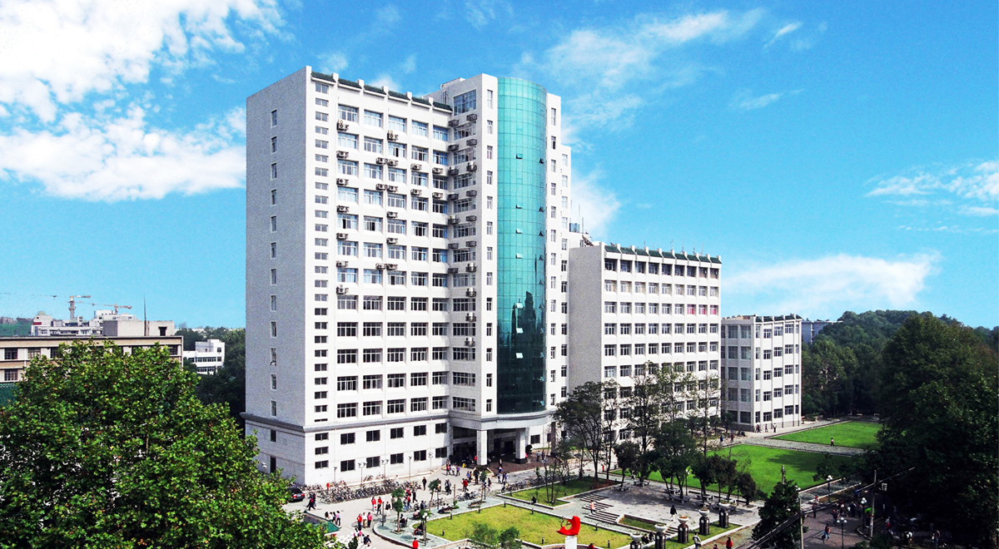
Visa Affairs
By April Huang
International Student Office

