Slide 1
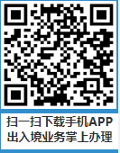
3、 App for Visa Application
QR code of APP for Visa Application

