Slide 1
1、 Accommodation Registration；
Registration within 24 hours；

Slide 2
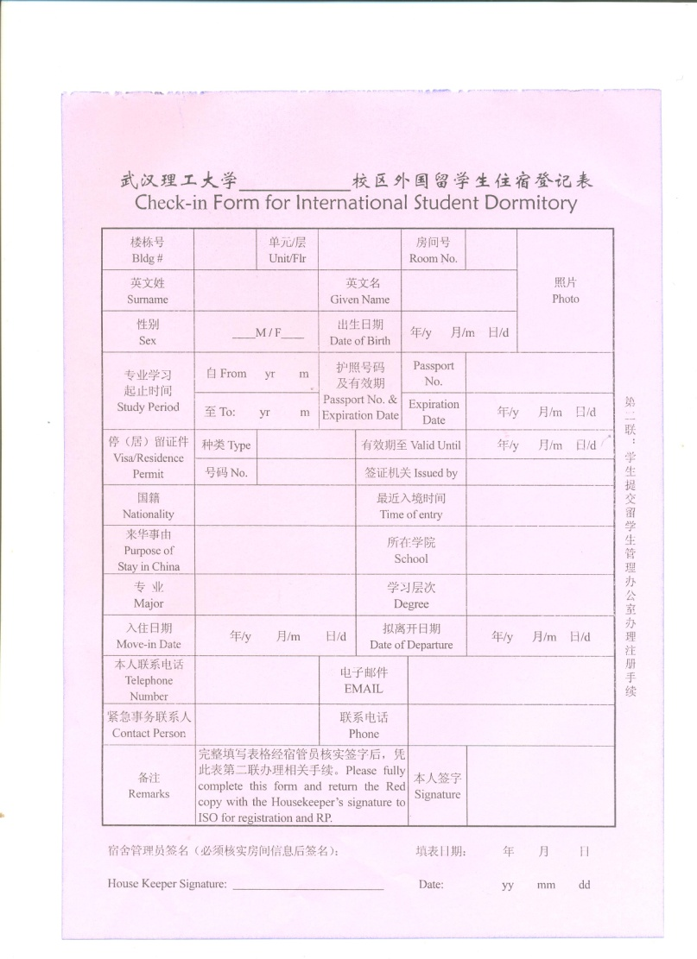
On campus

Slide 3
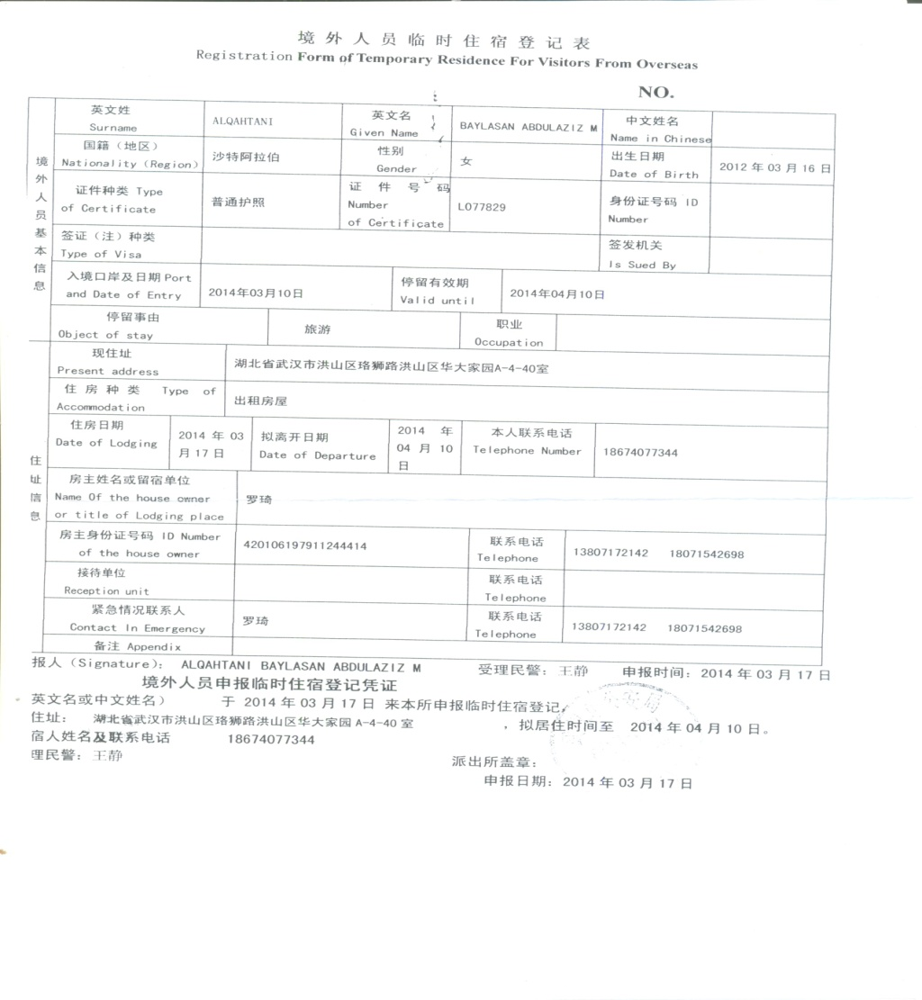
Off campus

