Slide 1
Chinese learning
Undergraduate in Chinese: HSK 5 to graduate!!!
Undergraduate in English: HSK 4 to graduate!!!
Master in Preparatory class: HSK 5 to enter the major!!!
Undergraduate in Preparatory class: HSK 4 to enter the major!!!

Slide 2
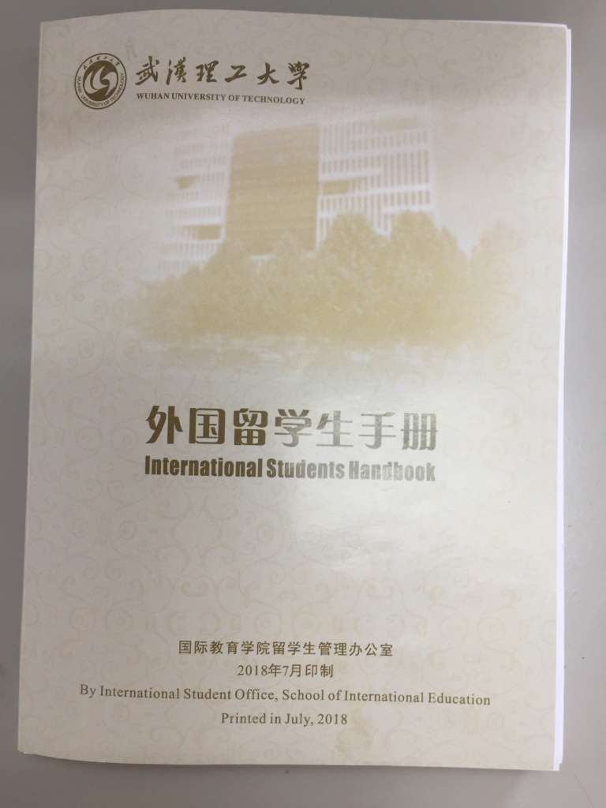
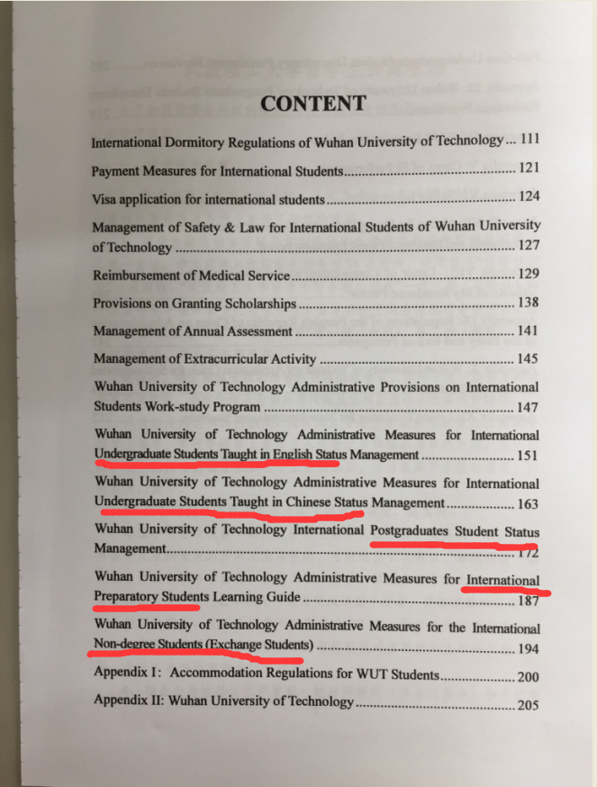
International Students Handbook

