Slide 1
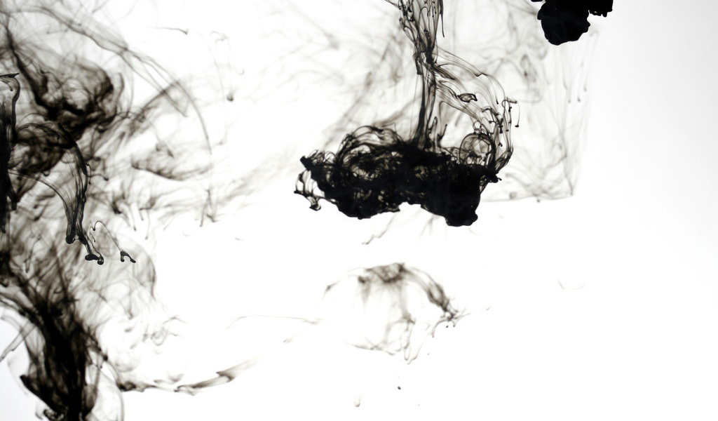
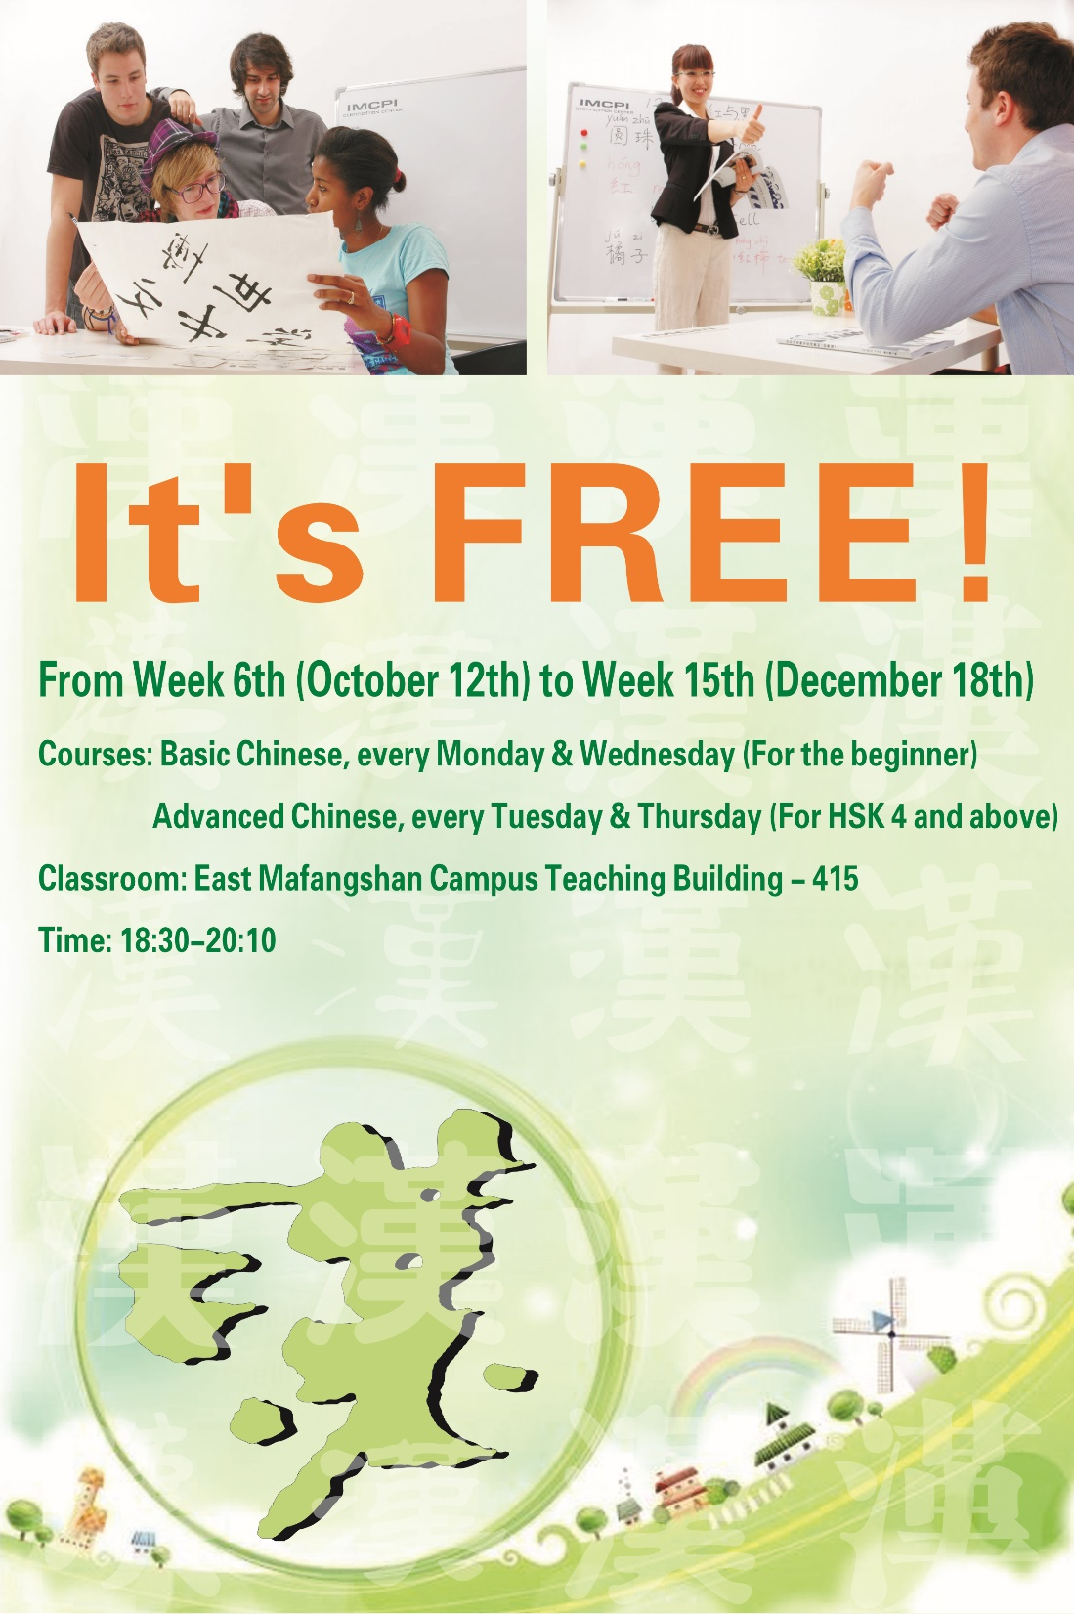
ONE CERTIFICATE
1.Undergradutate taught in English is required to pass the HSK4 level before graduation .
2.We prepared FREE classes for all the student who want to pass the HSK4 \HSK6 .
9
15
Course：HSK4，every Saturday morning
Classroom：JianHu Campus NO.1 building
Course ：HSK6，every Tuesday evening
Classroom：N9 Activity Center

