Slide 1
2 Specific Regulations
International Students Handbook – Page 57
How to change your room?
How many time you can change your room?

Slide 2
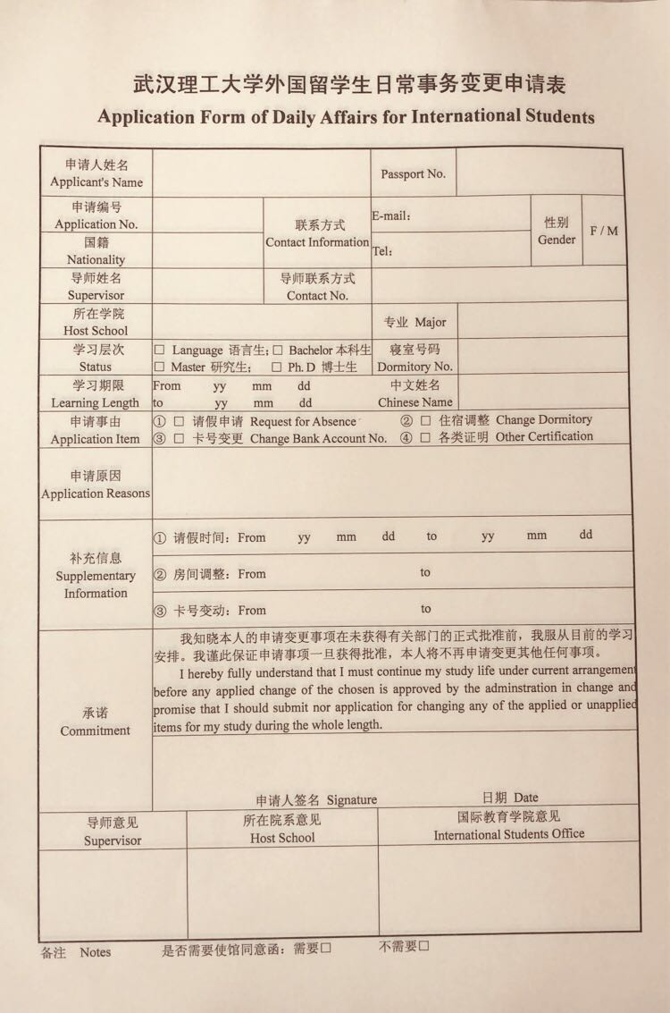
2 Specific Regulations

