Slide 1
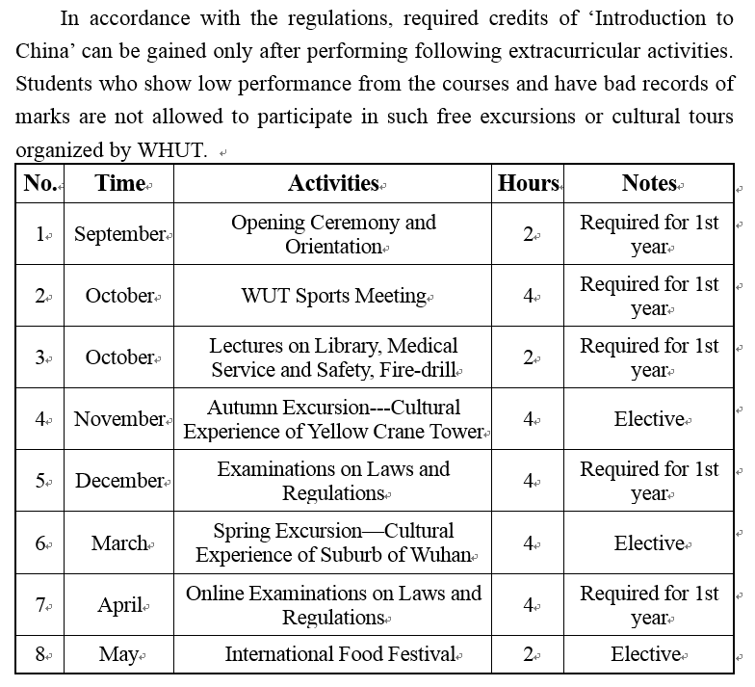
EXTRACURRICULAR
ACTIVITY
CREDITS

