Slide 1
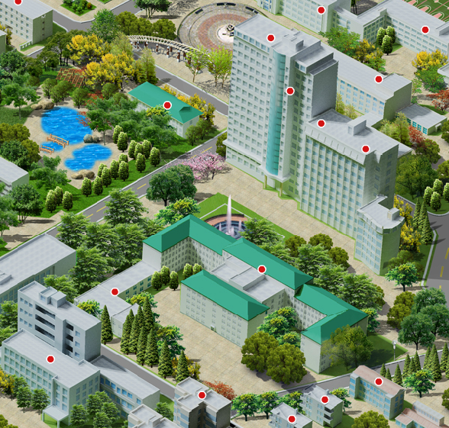
Counseling Service
Tel:87850042
教一楼西侧附楼
一楼

Slide 2

Guiyuan Buddhist Temple
见了便做，做了便放下，了了有何不了
Face it, deal with it, forget it afterward. Then nothing is difficult to you.

