Slide 1
Counseling & Chat
Counseling relation
Confidentiality
Professional skill
Notes:
缺乏支持系统常会导致各种问题无法得到及时的舒解，甚至支持系统的缺乏本身就是一个问题。

Slide 2
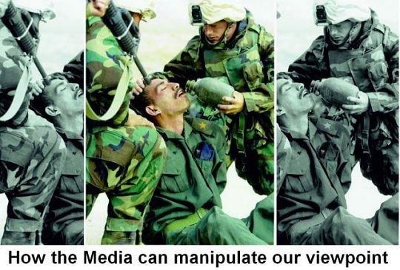
We only see what we want to see
Notes:
we do not see the world as it is, but how we think it is.
when you talk to a friend. they are your friends because you share the same views!

Slide 3
Counseling & Chat
Counseling relation
Confidentiality
Professional skill
Notes:
only two exception: you are planning to do illegal things; or harm yourself.

Slide 4
Counseling & Chat
Counseling relation
Confidentiality
Professional skill
Empathy
Notes:
你有没有觉得身边缺少能够真正理解你的人，又或者没有能够敞开心扉倾诉的人？

