Slide 1
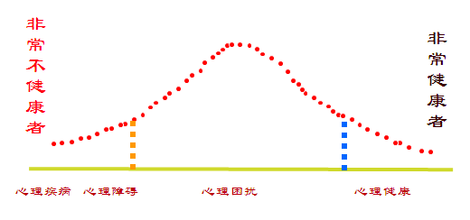
illness
disorder
distress
healthy
Can you realise it by yourself
Can you deal with it by yourself

Slide 2
illness
disorder
distress
healthy
realise
deal with
distress
disorder
illness
Yes
Yes
Yes
No
No
No

Slide 3
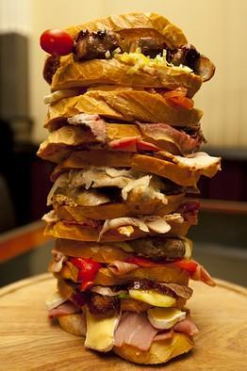
Mental Distress
academic, relationship, financial

Slide 4
Mental Disorder & Illness
Upset or depression?
Perfectionism or obsessive-compulsive disorder?
Duration: 2 weeks or longer
Impacts on life: unable to study or work
Notes:
Hypochondriasis （疑病症）& schizophrenia （精神分裂症）

Slide 5
Psychological Counseling

