Slide 1
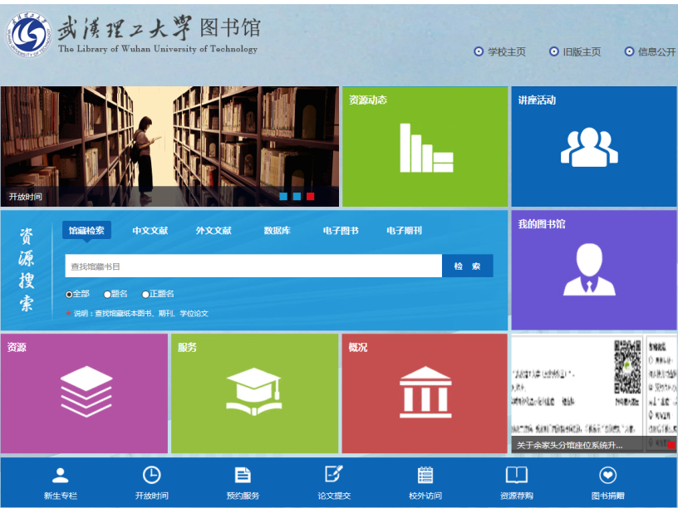
Library Website www.lib.whut.edu.cn
2. Introduction to Resources
University
Home Page
Last
Version
Information
Publication
About Library
Opening Time
Resource Layout
Newly-added database
Seminar
One-stop Searching
My Account
Resource
Service
About Library
News
Opening tmie
Thesis Submit
Book Recommendation
Library Orientation
Reservation
VPN
Donnation

Slide 2
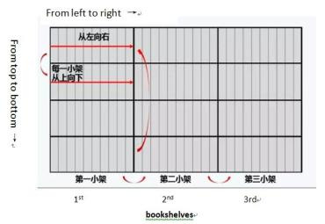
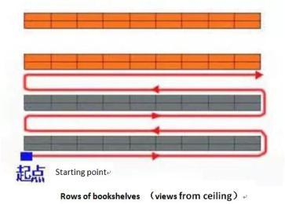
Borrow & Return
2. Introduction to Resources
1.Take your Student Card with you to enter the library and borrow books.
2.Arrive at the right book area or school library.
3.Locate the right book shelf.
You could find the indicator of Book Classification Number stickered on the both ends of book shelf. If the call number of the book you want is TP312.34（6）, you should find the book shelf TP312 First.
4.Find the book.
Then you need to know how book arranged on a bookshelf and rows of bookshelves. compare the call number of the book you want and the book in front of you. If the number is the former one is bigger, you need to go front shelves to find. If smaller you need to go back shelves to find.

Slide 3
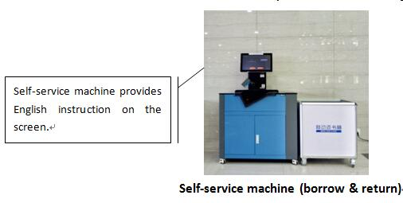
Borrow & Return
2. Introduction to Resources
Borrow books on Self-service machine by Student Card or go to counter for help. Return is the same procedure.

Slide 4
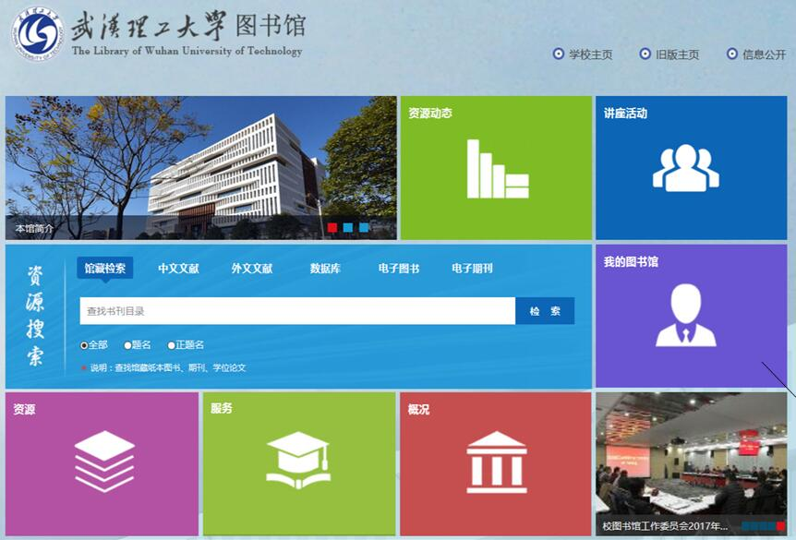
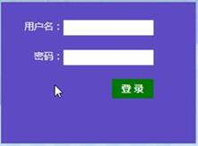
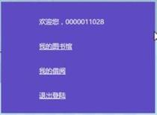
Check & Renew
2. Introduction to Resources
Account
Password
Student id
Library account
Borrowing Record
Logout

Slide 5
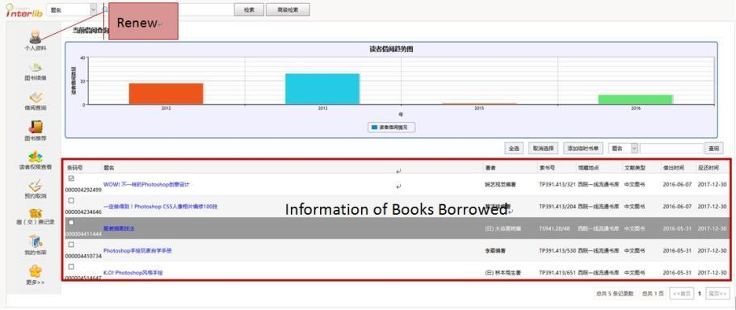
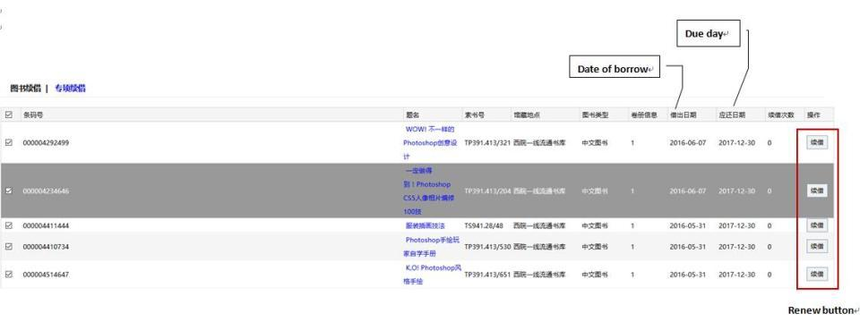
Check & Renew
2. Introduction to Resources
If you renew successfully, you could see the due day prolongs.
Renew is available within the period. If it passes the due day, it does not work. You need to pay fine and re-borrow.

Slide 6
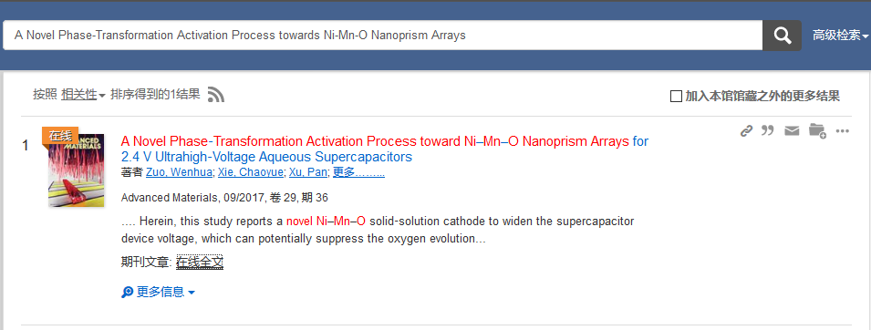
Search for E-resource
2. Introduction to Resources
Step 1
Step 2
View full article

