Slide 1

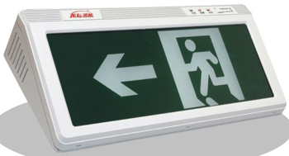

消防应急标志灯 Fire emergency lights
用图形、文字指示安全出口及其方向或位置的消防应急照明灯具。
Notes:
Indicating safety exit and direction or position with graphics, text

Slide 2





认识指示标志Recognize signs
逃 生Escape
火场上的指示标志能够让我们在最短的时间内找到最便捷的通往“生”的大门。
紧急出口 EXIT
滑动开门 SLIDE
推开 PUSH
Notes:
Recognize signs
The sign on the fire field allows us to find the most convenient door leading to “life” in the shortest possible time.

Slide 3








认识指示标志
逃 生
拉开PULL
消防梯 Fire ladder
疏散通道方向 Evacuation channel direction
发声警报器 Sound alarm
灭火设备 灭火器 Fire extinguisher equipment Fire extinguisher
灭火设备方向 Fire extinguishing equipment direction

Slide 4
火灾预防的方法 Method of fire prevention
1、不私自接拉临时电线。接拉临时电线极易导致供电线路超负荷，引发火灾；【案例2】2005年12月升升公寓一男生寝室因使用劣质插座，手机充电器长期通电，导致发热，引燃插座下的木板导致火灾。
Do not connect or pull temporary wires privately. Connecting or pulling temporary wires can easily cause the power supply line overloaded and cause fire; [Case 2] In December 2005, a fire happened at Shengsheng students dormitory due to the use of inferior outlets, The long-term power supply of the mobile phone charger causes the mobile phone to heat up and ignite the wooden boards under the power outlet and then cause fire.

Slide 5
2、 不在宿舍等公共场所使用电炉、电热器等电热设备，这些电热设备用电功率比较大，易导致供电线路超负荷，引发火灾；【案例3】2002年12月某天，狮城公寓一男生违章使用“热得快”烧水后外出，引发火灾，损失近千元。
2. Do not use electric heaters, and other electric heating equipment in public places such as dormitories. The electric power of these electric heating equipments are large, which can easily lead to overload of the power supply lines and cause fires; [Case 3] One day in December 2002, a student at Shicheng Apartment use "hotter" water illegally after going out, causing a fire, the loss of that fire nearly 1,000 yuan.

Slide 6
3 、不在宿舍等公共场所使用煤气炉、酒精炉等灶具。因为宿舍的地方较小，可燃物品较多，稍有疏忽将酿成火灾；
4 、不在宿舍点蜡看书。宿舍熄灯时间已经较晚，如再点蜡看书疲乏睡着，蜡烛易引燃蚊帐等可燃物，酿成火灾；
3, Do not use gas stoves, alcohol stoves and other stoves in public places such as dormitories. Because of the small size of dormitories and the high number of combustibles, a slight oversight will lead to fire;
4, Do not read books in the dormitory with wax. The dormitory has been turned off late. If you read the book again and you are tired and fall asleep, the candles can easily ignite the combustibles such as mosquito nets, causing a fire.

Slide 7
火灾预防的方法
5 、不卧床吸烟、乱扔烟头、火柴梗。人躺在床上很容易入睡，未熄的烟头或火柴梗掉在被褥等可燃物上，容易造成火灾；
6 、不乱焚烧杂物。焚烧杂物中遗留火种或失去控制时，容易造成火灾；
5, Do not smoke lying on the bed, do not throwing cigarette butts, matchsticks. It is easy for a person to fall asleep while lying on the bed. Unburned cigarette butts or matchsticks fall on flammable materials such as bedding, which can easily cause fire.
6, do not litter debris. When a fire is left behind in the burning of trash or when it is out of control, it is easily cause a fire;

Slide 8
7 、不将台灯靠近可燃物。台灯点燃时间过长，灯头发热靠近可燃物，易发生火灾；
8 、不要购买使用劣质电器产品，注意做到人走断电。人离开房间要关掉电器开关，拔下电源插头，确保电器彻底切断电源。
7. Do not place the lamp near the combustibles. When the lamp light for a long time, the top of the lamp will heat especially when it close to the combustible material and it will be easily to cause a fire.
8. Do not buy inferior electrical products, make sure cut off the electric when you leaving the room. When you leave the room, you need to turn off the electrical switch and unplug the power plug to ensure that the appliance completely cuts off the power.
请在此处添加副标题

Slide 9
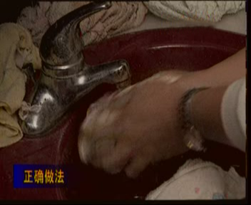
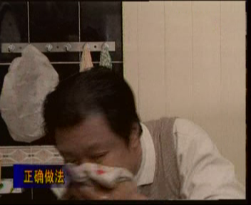
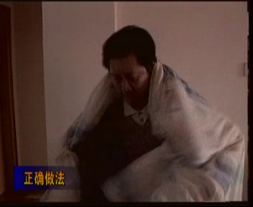
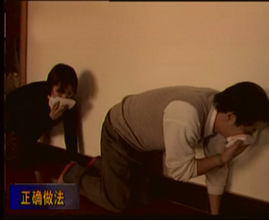

Slide 10
案例1 :2003年11月5日凌晨1点05分左右，余家头校区外事楼203房间发生火灾。当时房间无人，原因就是乱接电线，饮水机长期插在电源上，电线过热发生火灾，整个房间烧毁物品若干，房间薰黑，损失价值约人民币1万余元。
Case 1: At about 1:05 am on November 5, 2003, a fire broke out at Room 203 of the Foreign Affairs Building on Yujiatou Campus. At that time, there were no one in the room. The reason was that the wires were indiscriminately connected. The drinking fountains were plugged into the power supply for a long time. The wires were overheated and a fire broke out. The entire room and a number of items burned and the room was blackened. The value of the loss was about RMB 10,000.

Slide 11
案例2：2004年12月11日中午12点40分左右，东院学生1栋508发生火灾。系准备考研学生潘XX违规使用酒精炉煎中药所致，烧毁日常用品若干。
Case 2: On December 11, 2004, around 12:40 noon, a fire broke out in a no.1 building 508 of Dongyuan. A student named Pan prepared for the postgraduate entry exam use alcohol stoves fried Chinese medicine, burning a number of daily supplies.

Slide 12
案例3：2008年3月31日下午18：30，南湖教学区学生公寓3栋513室发生火灾，室内四名学生的日常生活和学习用品全部烧毁，价值12000余元（台式电脑1台4000元、现金1700元、四人书籍和生活用品及水电设施6300元），南湖保卫办接警后，及时拨打“119”报警。南湖、洪山二个消防中队出动四台消防车赶到现场将火扑灭。
初步认定：这起火灾是由于使用劣质电器产品（手机充电器）短路，引燃附近的书本等可燃物造成的。
Case 3: At 18:30 pm on March 31st, 2008, a fire broke out in Room 513, Building 3 of the student apartment in Nanhu Teaching Area. All four students’ daily life and school supplies were burned down, worth more than 12,000 yuan (1 set for desktop PC 4000 yuan. , cash 1,700 yuan, four people’s books and supplies and utilities 6,300 yuan), After receiving the alarm, NanHu Security Office promptly dial "119" alarm. Nanhu and Hongshan fire squadrons dispatched four fire engines to the scene to extinguish the fire.
Preliminary recognition: This fire was caused by the use of short-circuited, low-quality electrical products (mobile phone chargers) and the ignition of nearby books and other combustibles.

Slide 13
接下来，
我们将去到户外，一同来完成一场消防实操训练！
Next, we will go outdoors to complete a fire drill together!

Slide 14
谢谢大家
武汉理工大学
保卫处消防科

