Slide 1
Welcome to WHUT
William
March 16th, 2018

Slide 2
Agenda for Today
Medical Insurance
Students Social Society & Activities
Security Issues
Reference and Contact information

Slide 3
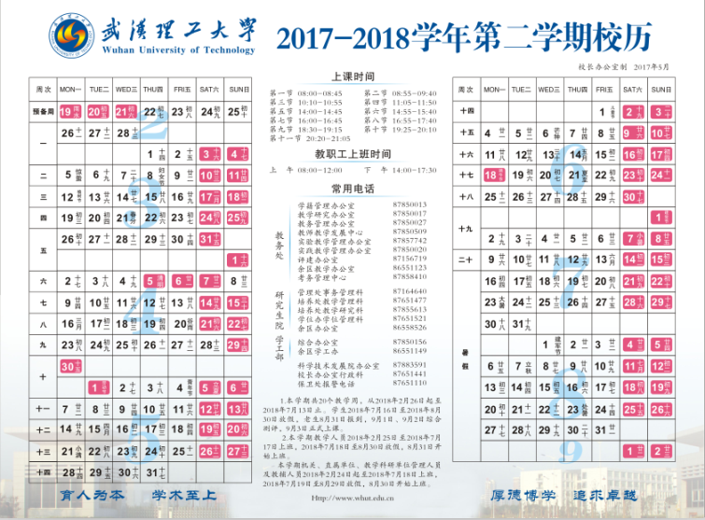

Slide 4
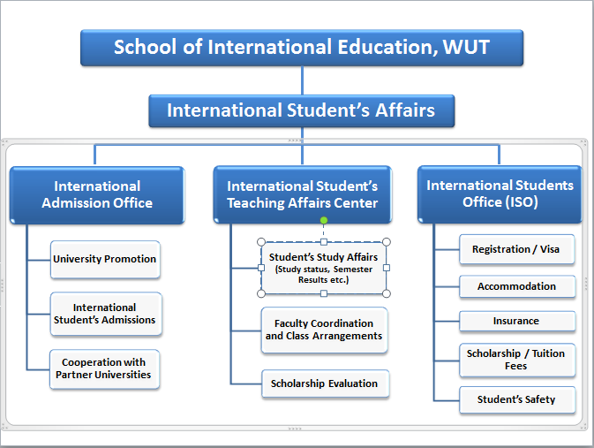

Slide 5
Medical Insurance
All students are covered by Medical Insurance. Either from CSC or from WHUT.
How to claim the Insurance ?
Call Ping An Insurance Company :
4008105119-1
Or International Student Office (Working time)
13387556113 (Non-working Time)

Slide 6
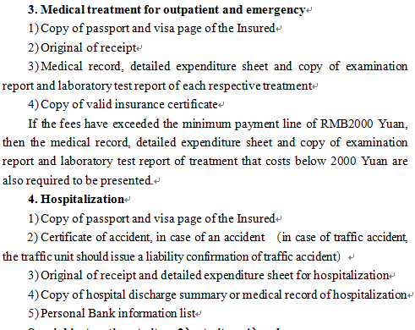
Medical Insurance

Slide 7
Students Social Society & Activities
ICEA (International Culture Exchange Association)
16 Credits from Cultural and Sports Activities
12 Credits are compulsory as follows:
Orientation, Sports Meeting, ..
8 Credits are elective as follows: Cultural Experience, Cultural Festival…
(“International Students Handbook”)
Questionnaire

Slide 8
Security Issues
Illegal Working
Religion related
Security Issues Summary

Slide 9
Illegal Working
Students are not allowed to work during his or her study；
Internship is allowed but need to be reported to the immigration;
If found, would be facing penalty other serious problem;

Slide 10
Religion related
University would not hold any places to hold any religious ritual；
No missionary work or any religious gathering is allowed;
For religious gathering, only lawful religious institutions could be allowed (mosques, churches etc.);

Slide 11
Reference

Slide 12
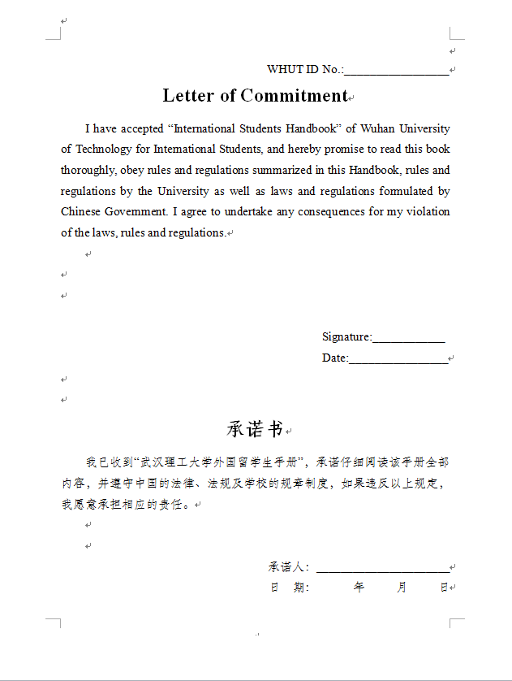

Slide 13
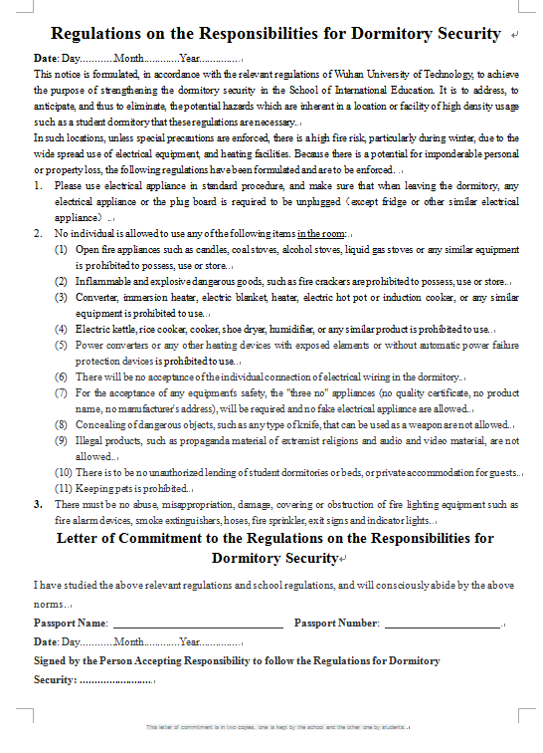

Slide 14
How to Find Us?
Mafangshan Campus: 87608608
#407, International Student Office, #4 Teaching Building, East of Mafangshan Campus
Nanhu Campus: 87590525
#204, South Wing, No. 9 International Building
Yujiatou Campus: 86554406
International Student Office, Yujiatou International Building

Slide 15
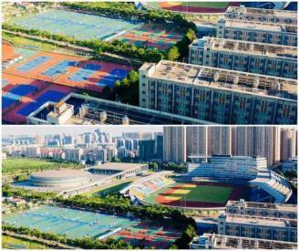
The END…

