Slide 1
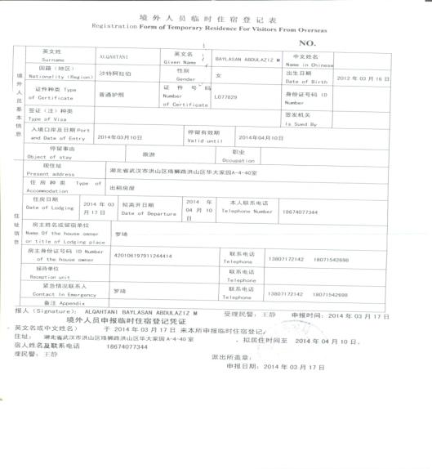
Off campus

Slide 2
2、 App for Visa Application 2018

Slide 3
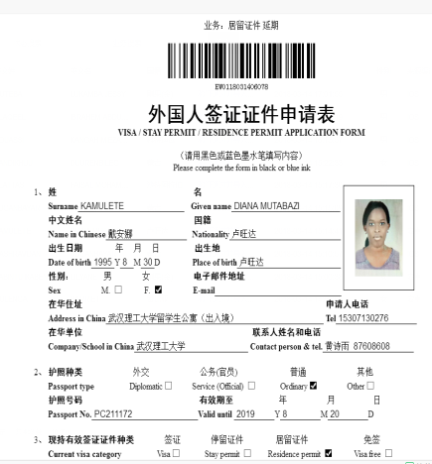
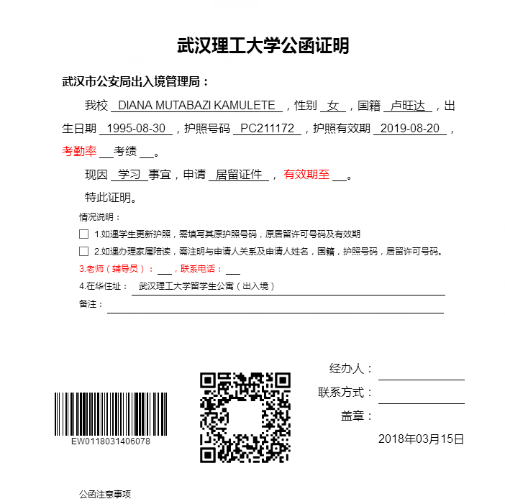
Certificate issued from the office

Slide 4
3、Other issue concerning visa expiration
1) X1 visa/X2 visa
2) Please apply the visa 10 working days in advance;
3) If expired, penalty or even study status to be cancelled;
4) Update your latest visa information and inform the office

Slide 5
4、New students' group visa application
Necessary Douments:
*Copy of Passport (information page、entrence stamp page、last visa page)
*2 passport size photos
*JW form(the yellow one)&Admission Notice
*Medical report from the physical examination center
*other Certificates issued from the office
*cash for paying the visa fee
within 1 year: 400 RMB
1 year to 3 years: 800 RMB
above 3 years: 1000 RMB

Slide 6
4、New students' group visa application
Time: 15th March (Thursday)

