Slide 1
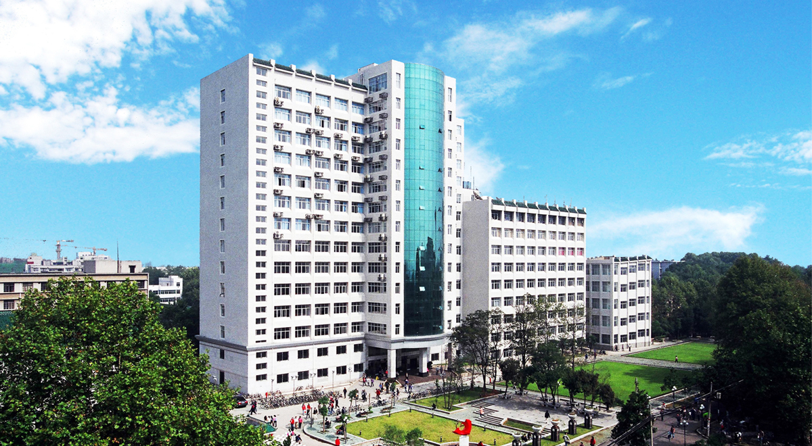
Visa Affairs
By April Huang
International Student Office

Slide 2
Visa Affairs
1、 Accommodation Registration；
2、App for Visa Application 2018；
3、 Other issue concerning visa expiration；
4、New students' group visa application.

Slide 3
1、 Accommodation Registration
(1)Registration within 24 hours when you arrive China；
(2)After you get a new resident permit.

Slide 4
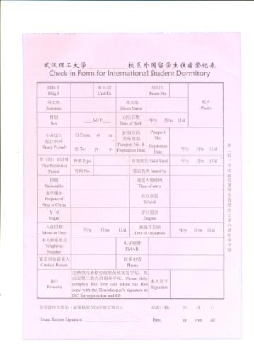
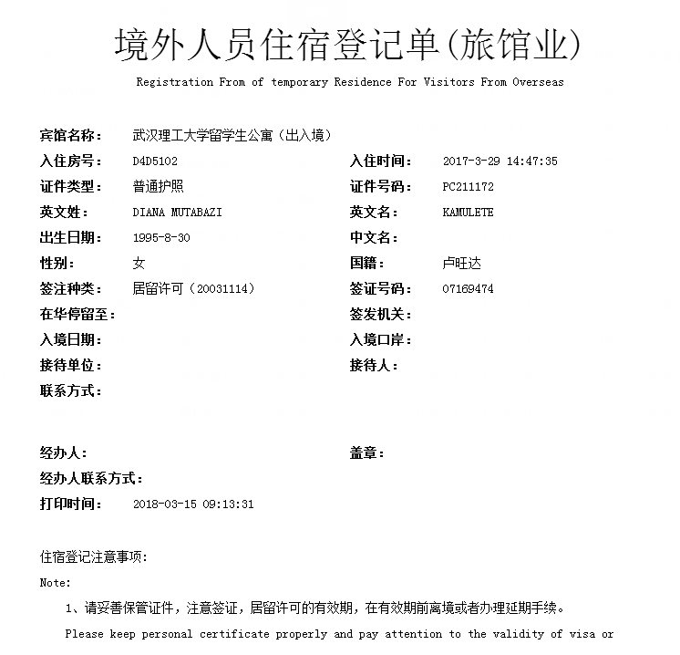
On campus

