Slide 1
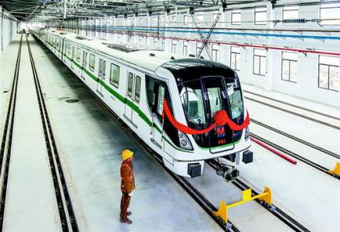
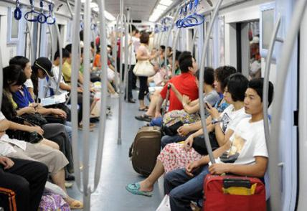
Wu Han Metro
5 Lines in operation now 9 Lines under construction Total metro traffic mileage will be 400 kilometers in 2020 Operation time is from 6:00 to 22:30. With 102 stations spread across the heart of Wuhan where we can take subway to the Airport, Train station and Commercial Zones in a very short time.

Slide 2
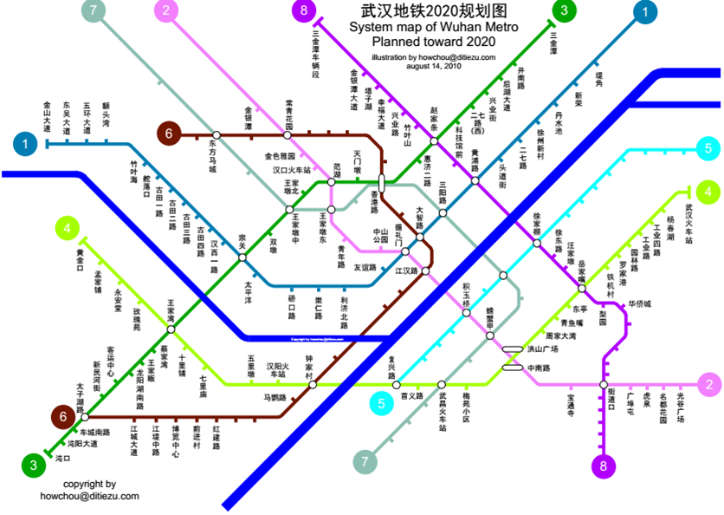
Map of Wuhan Metro Planned forward 2020

Slide 3
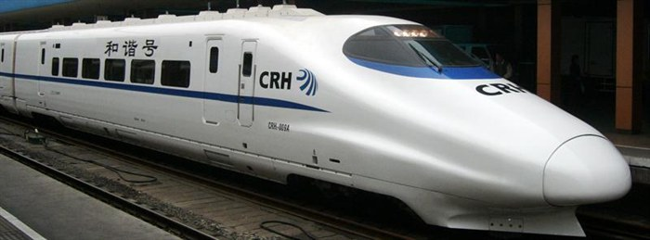
WuHan Railway Station
As one of the four major railway hubs in China, WuHan now has 3 High-Speed Railway stations There are over 70 trains departing from the station every day and more than 120 trains pass here. Every day trains depart in 7 directions from Wuhan to major cities in China including 22 provincial cities. Speed ：300km/h

Slide 4
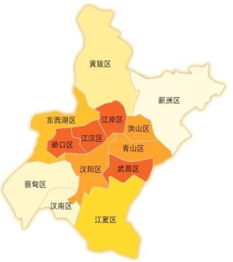
黑龙江
吉林
新疆
辽宁
甘肃
内蒙古
北京
宁夏
河北
青海
山西
山东
武汉Wuhan
陕西
河南
江苏
A major transportation hub ---by High-Speed Train(less than 6hrs)to any major city in all directions
西藏
湖北
HuBei
安徽
四川
江西
浙江
贵州
湖南
福建
台湾
云南
广西
广东
"Jiusheng Tongqu (i.e. the nine provinces' leading thoroughfare)"
海南

Slide 5
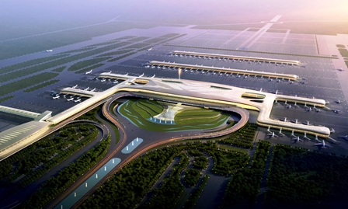
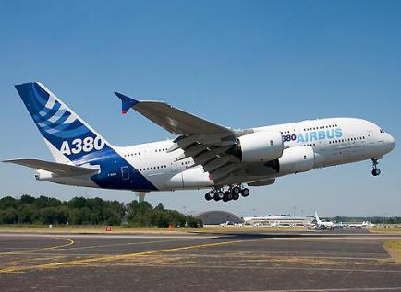
Wuhan Tianhe International Airport
One of the 8 major regional airline hubs with the largest size and the most complete functions in the central China Airport passenger throughput (international & domestic) ranked top in the central China in 2015 39 International and domestic airlines allow you to fly directly to Asia，Europe，Africa and Oceania International lines will be doubled in Five years.

Slide 6
Wu Han Special Food
Hot-and-Dry Noodles
Duck Neck

Slide 7
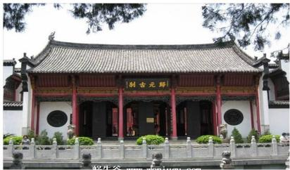
Sceneries in Wu Han
Yellow Crane Tower
Gui Yuan Temple

Slide 8
武汉理工欢迎你
Welcome to WUT
Welcome to apply for studying in WUT by Chinese Government Scholarship
•apply at CSC’s online system and input agency number10497 presents WUT at beginning;
•download scholarship apply form when finish apply online;
You could read more on CSC’s website for this program’s details: http://www.campuschina.org/scholarshipdetailen.aspx?cid=97&id=3056

Slide 9
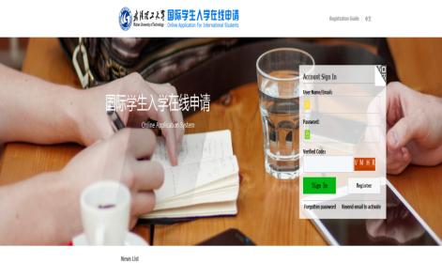
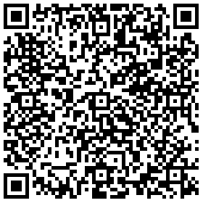
武汉理工欢迎你
Welcome to WUT
Apply online: admission.whut.edu.cn
Tele/Fax: +86-27-8716 6636
Email: fstudent@whut.edu.cn

