Slide 1
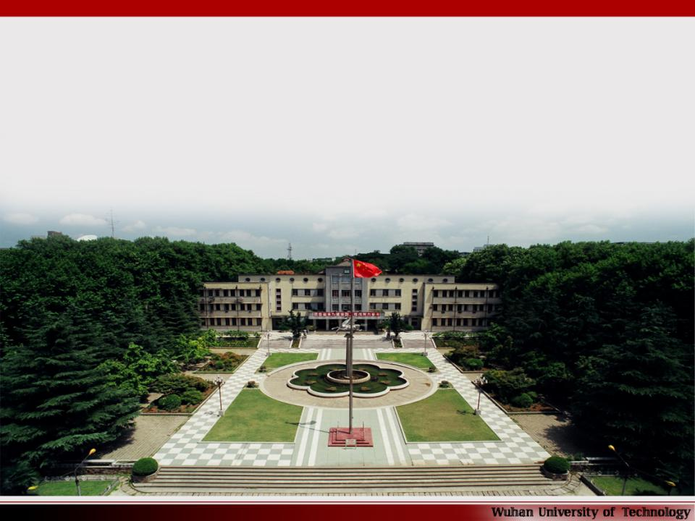
武汉理工大学
Wuhan University of Technology
厚德博学 追求卓越
Sound in Morality, Broad in Learning and Pursuing Excellence

Slide 2
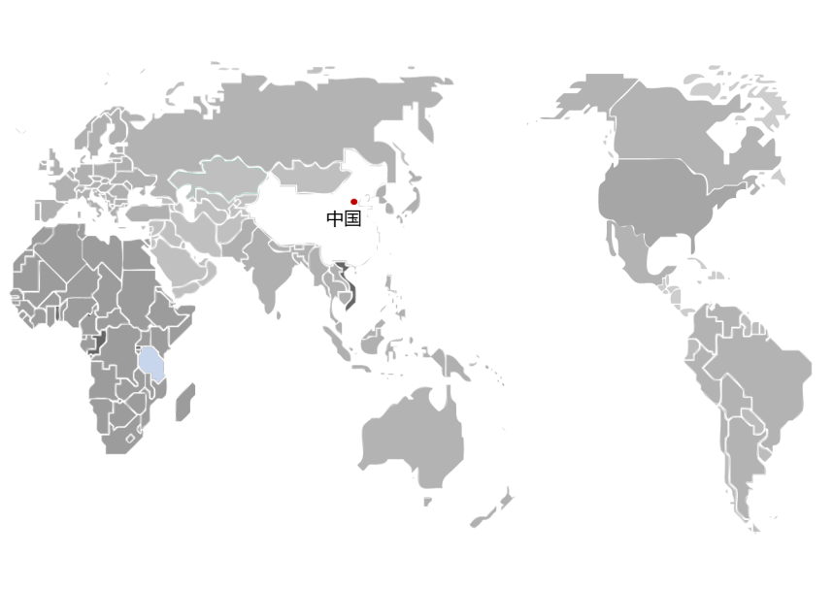
China

Slide 3
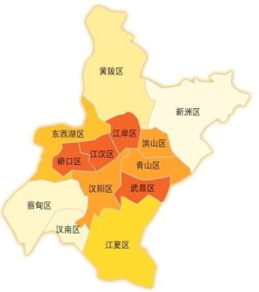
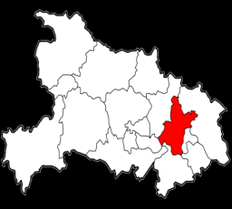
黑龙江
吉林
新疆
辽宁
甘肃
内蒙古
北京
宁夏
河北
青海
山西
山东
武汉Wuhan
陕西
河南
江苏
西藏
湖北
HuBei
安徽
四川
江西
浙江
贵州
湖南
福建
台湾
云南
广西
广东
海南

Slide 4
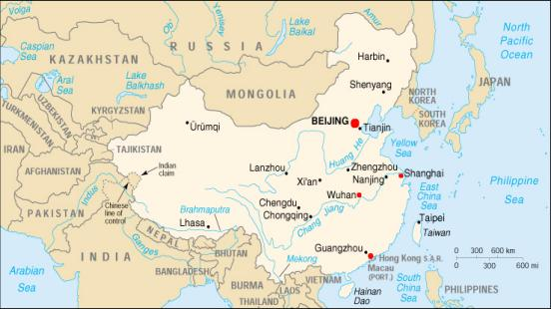
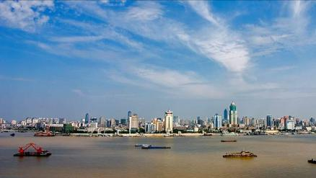
Profile of WUT
Location:
Wuhan
- the capital city of Hubei province, China;
- the most populous city in Central China;
- recognized as the political, economic, financial, cultural, educational and transportation center of central China.

Slide 5
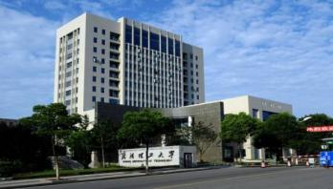
Profile of WUT
● merged on 27th May 2000 by the authorization of the State Council, from three
former universities:
- Wuhan University of Technology (1948)
- Wuhan University of Transportation (1946)
- Wuhan Automotive Polytechnic University (1958).
● a Chinese key university under the direct administration of Ministry of Education.
● one of the first universities constructed in priority by the “State 211 Project”(which aims to rasie the research standardrs) for Chinese higher education institutions.
● Material Science and Engineering entered the “State 985 Project ” as the world's
excellent disciplines.

Slide 6
Profile of WUT
● Three disciplines were listed in ESI world's top 1% ranking in 2012:
- Materials
- Engineering ( including Naval Architecture and Ocean Engineering,
Transportation Engineering, Mechatronic and Automotive Engineering,
Civil Engineering, Resources and Environmental Engineering, etc.)
- Chemistry

Slide 7
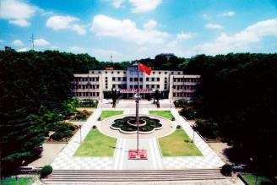
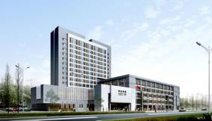
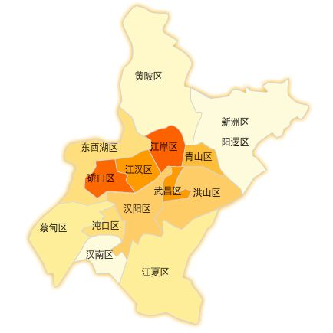
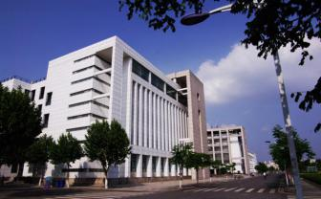
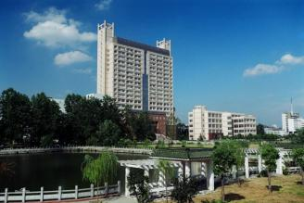
YuJiaTou Campus
MaFangShan Campus
NanHu Campus
JianHu Campus

Slide 8
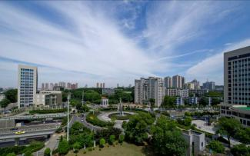
Profile of WUT
4 campuses :
Total occupying land area: 267 hectare
Total building area: 1.63 million m²

Slide 9
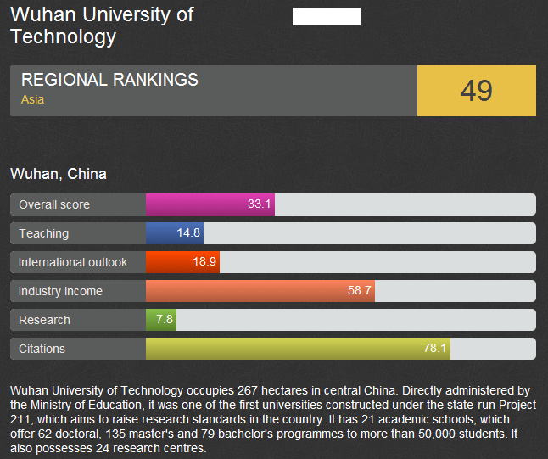
Profile of WUT
● ranked 49 according to Times Higher Education's
Asia University Rankings 2014 Top 100

Slide 10
Profile of WUT
Chinese Universities listed in Asia University Rankings 2013 and 2014 Top 100
University |  | 2014 | 2013
 |  | Ranking | Ranking
1 | Peking University | 5 | 4
2 | Tsinghua University | 6 | 6
3 | University of Sci. & Tech. of China | 21 | 25
4 | Fudan University | 25 | 24
5 | Renmin University of China | 32 | 41
6 | Nanjing University | 36 | 35
7 | Zhejiang University | 41 | 45
8 | Shanghai Jiao Tong University | 47 | 40
9 | Wuhan University of Technology | 49 | 58
10 | Sun Yat-sen University | 56 | 51
11 | Tianjin University | 62 | Not in the list
12 | Wuhan University | 64 | 58
13 | East China Normal University | 67 | Not in the list
14 | Harbin Institute of Technology | 69 | 66
15 | Dalian University of Technology | 79 | 80
16 | Hunan University | 81 | Not in the list
17 | Tongji University | 87 | Not in the list
18 | Xi'an Jiaotong University | 95 | 89
19 | Huazhong University of Sci. & Tech. | Not in the list | 99

Slide 11
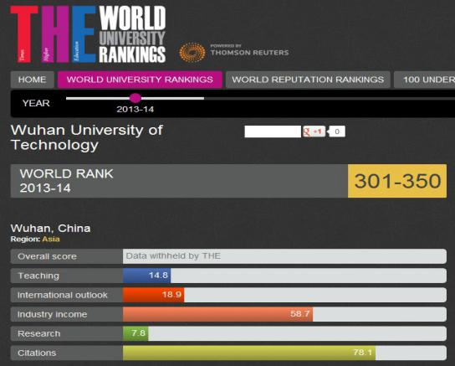
Profile of WUT
● ranked 301-350 according to Times Higher Education's
World University Rankings 2013-2014 , only 10
universities were listed in the ranking in mainland China.

Slide 12
Why?
I Choose
WUT
Advantageous Disciplines
International Education
Campus Activities
Life in Wuhan

Slide 13
Advantageous Discipline
International Education
Campus Activities
Life in Wuhan
Wuhan University of Technology, one of the key institutions of higher learning under the direct administration of China’s Ministry of Education, is included in Project 211 & Innovation Platform for Advantageous Disciplines under Project 985. Since 2012 three disciplines of Materials Science, Engineering & Chemistry are ranked as top 1% by Essential Scientific Index (ESI). By Times Higher Education in 2015, WUT is ranked 60th among Top 100 Asian Universities.

